Slide 1
PYTHON PROJECT
Drawing an image through rotating vectors , and converting an image into svg format
MADE BY – utkarsh prabhat
23EEBOB56

Slide 2
LIBRARIES USED
PYQT5
MATPLOTLIB
OPENCV
SVGPATHTOOLS
POTRACE
IMAGICK
NUMPY
PYINSTALLER

Slide 3
PROJECT OBJECTIVES
USE VARIOUS IMAGE EDGE DETECTION TECHNIQUES
CONVERTING AN IMAGE INTO SVG FORMAT AFTER EDGE DETECTION
MATHEMATICALA DEMONSTRATION OF FOURIER SERIES
GET A GRASP OF PYTHON GUI LIBRARIES
LEARN ABOUT LIBRARIES FOR EXAMPLE
MATPLOTLIB, NUMPY , OPENCV , PYQT5
POTYRACE , ETC

Slide 4
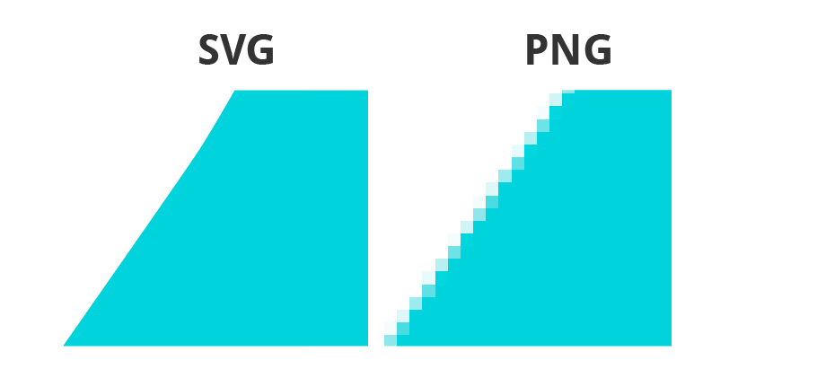
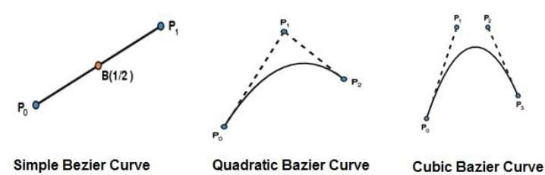
SVG VS NORMAL IMAGES
BEZIER CURVES

Slide 5
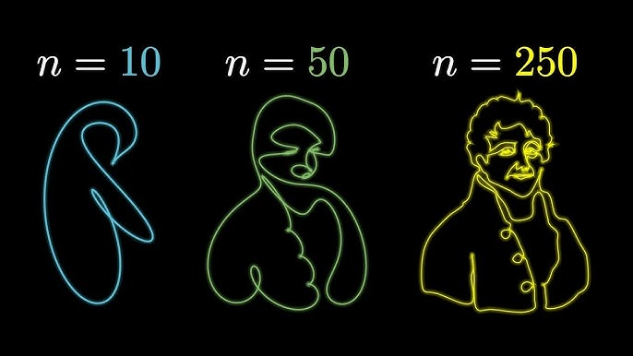
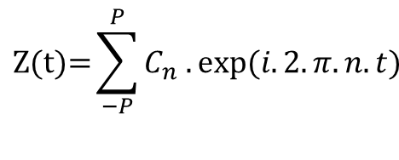

TRACING PATH THROUGH ROTATING VECTORS
$$\text{Z}\text{(}\text{t}\text{)=}\sum_{−P}^{P}{C_{n} .exp⁡(i.2.π.n.t)}$$
$$C_{n}=\int_{0}^{1}{Z\left(t\right).\exp\left(−i.2.π.n.t\right).dt}$$

Slide 6

CANNY EDGE DETECTION

Slide 7

BITMAP

Slide 8
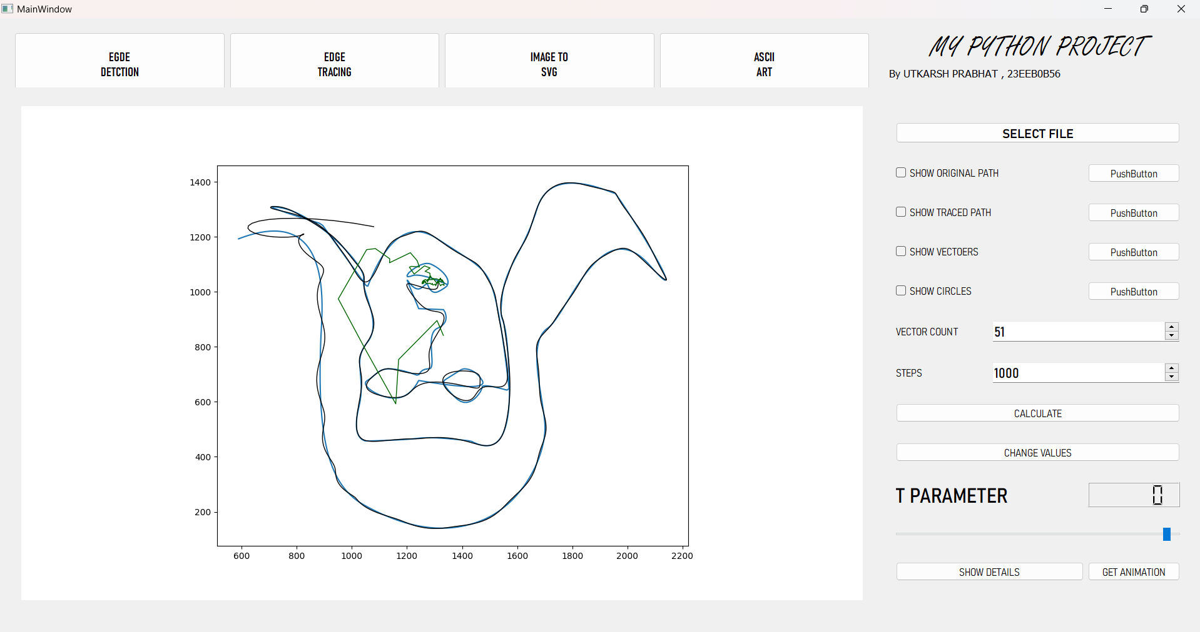
PROJEFCT SNAPSHOT

